Slide 1
Chapter -1
Transaction Management and Concurrency Control

Slide 2
Introduction
Transaction processing systems are systems with large databases and hundreds of concurrent users executing database transactions.
Examples of such systems include:
airline reservations, banking, credit card processing, online retail purchasing, stock markets, supermarket checkouts, and many other applications.
A transaction, is a unit of program execution that accesses and possibly updates various data items.
It is either completed in its entirety or not done at all.
This logical unit of database processing includes one or more access operations (read - retrieval, write - insert or update, delete).

Slide 3
… Cont’d
According to the number of users who can use the system concurrently a DBMS is classified into two
Single-User System:
At most one user at a time can use the system.
mostly restricted to personal computer systems
Multiuser System:
Many users can access the system concurrently.
E.g., airline reservations system, Database systems used in banks, insurance agencies, stock exchanges, supermarkets and so on.
The coordination of the simultaneous execution of transactions in a multiuser database system is known as concurrency control
Concurrency control can be:
Interleaved
Concurrent execution of processes is interleaved in a single CPU
Parallel processing:
Processes are concurrently executed in multiple CPUs.

Slide 4
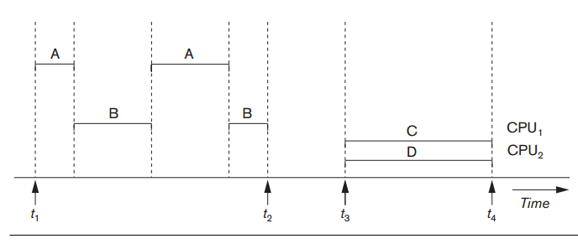
… Cont’d
Interleaved processing vs parallel processing of concurrent transactions

Slide 5
Transaction, Database items, Read and Write operations
A Transaction: logical unit of database processing that includes one or more access operations (read -retrieval, write - insert or update, delete).
One way of specifying the transaction boundaries is by specifying explicit begin transaction and end transaction statements in an application program Transaction boundaries:
Begin transaction and End transaction.
All database access operations between the two are considered as forming one transaction
An application program may contain several transactions separated by the Begin and End transaction boundaries.
If the database operations in a transaction do not update the database but only retrieve data, the transaction is called a read-only transaction; otherwise it is known as a read-write transaction.

Slide 6
… Cont’d
A database is basically represented as a collection of named data items
A data item can be a database record, but it can also be a larger unit such as a whole disk block, or even a smaller unit such as an individual field (attribute) value of some record in the database.
The size of a data item is called its granularity
The basic database access operations that a transaction can include are read and write
read_item(X): Reads a database item named X into a program variable.
write_item(X): Writes the value of program variable X into the database item named X.

Slide 7
… Cont’d
Basic unit of data transfer from the disk to the computer main memory is one block.
In general, a data item (what is read or written) will be the field of some record in the database, although it may be a larger unit such as a record or even a whole block.
Executing a read_item(X) command includes the following steps:
1. Find the address of the disk block that contains item X.
2. Copy that disk block into a buffer in main memory (if that disk block is not already in some main memory buffer).
3. Copy item X from the buffer to the program variable named X.

Slide 8
… Cont’d
Executing a write_item(X) command includes the following steps:
1. Find the address of the disk block that contains item X.
2. Copy that disk block into a buffer in main memory (if that disk block is not already in some main memory buffer).
3. Copy item X from the program variable named X into its correct location in the buffer.
4. Store the updated block from the buffer back to disk (either immediately or at some later point in time).

Slide 9
… Cont’d
A transaction can have one of two outcomes
1. Committed: If a transaction completed successfully and the database reaches a new consistent state.
2. Aborted: If the transaction does not executed successfully. The database must be restored to the consistent state it was, before the transaction started. Such a transaction is called rolled back or undone.
For recovery purposes, the system needs to keep track of when the transaction starts, terminates, and commits or aborts.

Slide 10
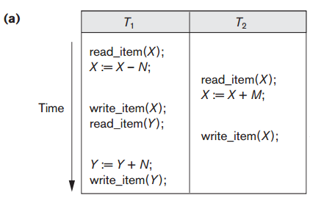

Why Concurrency Control is needed
The coordination of the simultaneous execution of transactions in a multiuser database system is known as concurrency control
Concurrency control is important because the simultaneous execution of transactions over a shared database can create several data integrity and consistency problems.
The four main problems are lost updates, uncommitted data, Unrepeatable Read Problem ,and inconsistent retrievals. 1. The Lost Update Problem
This occurs when two transactions that access the same database items have their operations interleaved in a way that makes the value of some database item incorrect.
For example, if X = 80 at the start (originally there were 80 reservations on the flight), N = 5 (T1 transfers 5 seat reservations from the flight corresponding to X to the flight corresponding to Y), and M = 4 (T2 reserves 4 seats on X), the final result should be X = 79. However, in the interleaving of operations shown in Figure 21.3(a), it is X = 84 because the update in T1 that removed the five seats from X was lost.

Slide 11
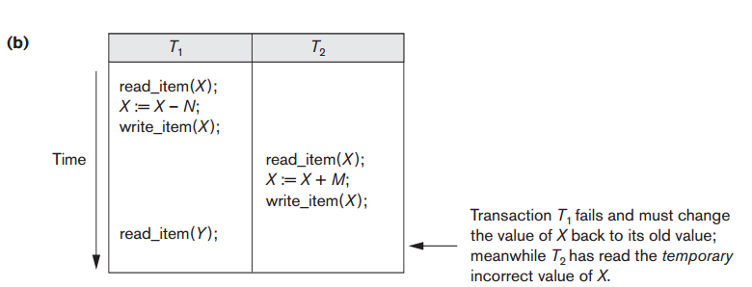
… cont’d
2. The Temporary Update (or Dirty Read) Problem
This occurs when one transaction updates a database item and then the transaction fails for some reason.
The updated item is accessed by another transaction before it is changed back to its original value.
Example where T1 updates item X and then fails before completion, so the system must change X back to its original value. Before it can do so, however, transaction T2 reads the temporary value of X, which will not be recorded permanently in the database because of the failure of T1.
The value of item X that is read by T2 is called dirty data because it has been created by a transaction that has not completed and committed yet; hence, this problem is also known as the dirty read problem.

Slide 12
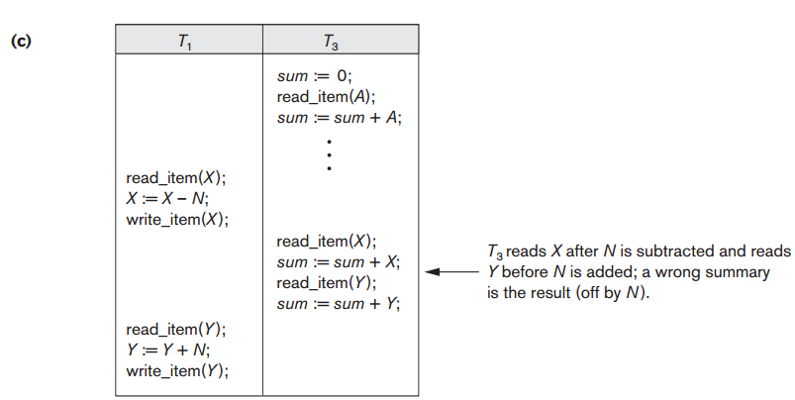
… cont’d
3. The Incorrect Summary Problem
If one transaction is calculating an aggregate(total) summary function on a number of records while other transactions are updating some of these records, the aggregate function may calculate some values before they are updated and others after they are updated.
T1 is calculating aggregation but T2 is updating some records
Some values updated before and some values updated after
So the value of aggregation after and before updating will be different

Slide 13
… cont’d
4. The Unrepeatable Read Problem
Another problem that may occur is called unrepeatable read, where a transaction T reads the same item twice and the item is changed by another transaction T’ between the two reads. Hence, T receives different values for its two reads of the same item.
This may occur, for example, if during an airline reservation transaction, a customer inquires about seat availability on several flights.
When the customer decides on a particular flight, the transaction then reads the number of seats on that flight a second time before completing the reservation, and it may end up reading a different value for the item.

Slide 14
Why Recovery Is Needed
Whenever a transaction is submitted to a DBMS for execution, the system is responsible for making sure that either all the operations in the transaction are completed successfully and their effect is recorded permanently in the database, or that the transaction does not have any effect on the database or any other transactions.
In the first case, the transaction is said to be committed, whereas in the second case, the transaction is aborted.
Database recovery restores a database from a given state (usually inconsistent) to a previously consistent state after a failure.
It is a service provided by the DBMS to ensure that the database is reliable and remains in a consistent state in the presence of failure.
If a transaction fails after executing some of its operations but before executing all of them, the operations already executed must be undone and have no lasting effect.

Slide 15
Types of Failures
A computer failure (system crash):
A hardware or software error occurs in the computer system during transaction execution.
If the hardware crashes, the contents of the computer’s internal memory may be lost.
A transaction or system error:
Some operation in the transaction may cause it to fail, such as integer overflow or division by zero.
Transaction failure may also occur because of erroneous parameter values or because of a logical programming error.
In addition, the user may interrupt the transaction during its execution.

Slide 16
… Cont’d
Local errors or exception conditions detected by the transaction:
Certain conditions necessitate cancellation of the transaction.
For example, data for the transaction may not be found. A condition, such as insufficient account balance in a banking database, may cause a transaction, such as a fund withdrawal from that account, to be canceled.
A programmed abort in the transaction causes it to fail.
Concurrency control enforcement:
The concurrency control method may decide to abort the transaction, to be restarted later, because it violates serializability or because several transactions are in a state of deadlock .

Slide 17
… Cont’d
Disk failure:
Some disk blocks may lose their data because of a read or write malfunction or because of a disk read/write head crash.
This may happen during a read or a write operation of the transaction.
Physical problems and catastrophes:
This refers to an endless list of problems that includes power or air-conditioning failure, fire, theft, sabotage, overwriting disks or tapes by mistake, and mounting of a wrong tape by the operator.

Slide 18
Transaction and System Concepts
A transaction is an atomic unit of work that is either completed in its entirety or not done at all.
For recovery purposes, the system needs to keep track of when the transaction starts, terminates, and commits or aborts.
Transaction states:
Active state
Partially committed state
Committed state
Failed state
Terminated State

Slide 19
… Cont’d
Active state: transaction is being executed. E.g. insertion or updating data.
Partially committed: transaction executes it last operation
Committed : transaction executes all its operations successfully.
Failed : a transaction is in a failed state if any of the checks made by the database recovery system fails.
Terminated : once transaction terminated then two operations can be performed or end of transactions

Slide 20
… Cont’d
Recovery manager keeps track of the following operations:
begin_transaction: This marks the beginning of transaction execution.
read or write: These specify read or write operations on the database items that are executed as part of a transaction.
end_transaction: This specifies that read and write transaction operations have ended and marks the end limit of transaction execution.
At this point it may be necessary to check whether the changes introduced by the transaction can be permanently applied to the database or whether the transaction has to be aborted because it violates concurrency control or for some other reason.

Slide 21
… Cont’d
commit_transaction: This signals a successful end of the transaction so that any changes (updates) executed by the transaction can be safely committed to the database and will not be undone.
rollback (or abort): This signals that the transaction has ended unsuccessfully, so that any changes or effects that the transaction may have applied to the database must be undone.

Slide 22
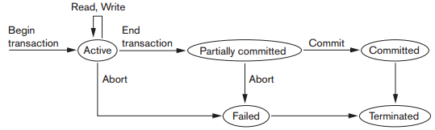
… Cont’d
Recovery techniques use the following operators:
undo: Similar to rollback except that it applies to a single operation rather than to a whole transaction.
redo: This specifies that certain transaction operations must be redone to ensure that all the operations of a committed transaction have been applied successfully to the database.
State transition diagram illustrating the states for transaction execution

Slide 23
The System Log
Log (DBMS Journal): The log keeps track of all transaction operations that affect the values of database items.
This information may be needed to permit recovery from transaction failures.
The log is a sequential, append-only file that is kept on disk, so it is not affected by any type of failure except for disk or catastrophic failure.
In addition, the log is periodically backed up to archival storage (tape) to guard against such catastrophic failures.
The types of entries with respect to the corresponding action that are written to the log file are called log records.

Slide 24
… Cont’d
T in the following discussion refers to a unique transaction-id that is generated automatically by the system and is used to identify each transaction:
Types of log record:
[start_transaction,T]: Records that transaction T has started execution.
[write_item,T,X,old_value,new_value]: Records that transaction T has changed the value of database item X from old_value to new_value.
[read_item,T,X]: Records that transaction T has read the value of database item X.
[commit,T]: Records that transaction T has completed successfully, and affirms that its effect can be committed (recorded permanently) to the database.
[abort,T]: Records that transaction T has been aborted.

Slide 25
… Cont’d
Protocols for recovery that avoid cascading rollbacks do not require that read operations be written to the system log, whereas other protocols require these entries for recovery.
Strict protocols require simpler write entries that do not include new_value.

Slide 26
Recovery using log records
If the system crashes, we can recover to a consistent database state by examining the log and using one of the techniques.
Because the log contains a record of every write operation that changes the value of some database item, it is possible to undo the effect of these write operations of a transaction T by tracing backward through the log and resetting all items changed by a write operation of T to their old_values.
We can also redo the effect of the write operations of a transaction T by tracing forward through the log and setting all items changed by a write operation of T (that did not get done permanently) to their new_values.

Slide 27
Commit Point of a Transaction
Definition a Commit Point:
A transaction T reaches its commit point when all its operations that access the database have been executed successfully and the effect of all the transaction operations on the database has been recorded in the log.
Beyond the commit point, the transaction is said to be committed, and its effect is assumed to be permanently recorded in the database.
The transaction then writes an entry [commit,T] into the log.
Roll Back of transactions:
Needed for transactions that have a [start_transaction,T] entry into the log but no commit entry [commit,T] into the log.

Slide 28
… Cont’d
Redoing transactions:
Transactions that have written their commit entry in the log must also have recorded all their write operations in the log; otherwise they would not be committed, so their effect on the database can be redone from the log entries. (Notice that the log file must be kept on disk.)
At the time of a system crash, only the log entries that have been written back to disk are considered in the recovery process because the contents of main memory may be lost.)
Force writing a log:
Before a transaction reaches its commit point, any portion of the log that has not been written to the disk yet must now be written to the disk.
This process is called force-writing the log file before committing a transaction.

Slide 29
Desirable Properties of Transactions
ACID properties: they should be enforced by the concurrency control and recovery methods of the DBMS
Atomicity(all or none): A transaction is an atomic unit of processing; it is either performed in its entirety or not performed at all.
Consistency preservation(correctness): A correct execution of the transaction must take the database from one consistent state to another.
Isolation: A transaction should not make its updates visible to other transactions until it is committed; this property, when enforced strictly, solves the temporary update problem and makes cascading rollbacks of transactions unnecessary.
Durability or permanency: Once a transaction changes the database and the changes are committed, these changes must never be lost because of subsequent failure.

Slide 30
Schedules of Transaction
Transaction schedule or history:
When transactions are executing concurrently in an interleaved fashion, the order of execution of operations from the various transactions forms what is known as a transaction schedule (or history).
Schedules – sequences that indicate the chronological order in which instructions of concurrent transactions are executed.
A schedule (or history) S of n transactions T1, T2, …, Tn:
It is an ordering of the operations of the transactions subject to the constraint that, for each transaction Ti that participates in S, the operations of T1 in S must appear in the same order in which they occur in T1.
Note, however, that operations from other transactions Tj can be interleaved with the operations of Ti in S.

Slide 31
… Cont’d
The schedule of the above figure , which we shall call Sa, can be written as follows in this notation:
Sa: r1(X); r2(X); w1(X); r1(Y); w2(X); w1(Y);

Slide 32
… Cont’d
Two operations in a schedule are said to conflict if they satisfy all three of the following conditions:
(1) they belong to different transactions;
(2) they access the same item X; and
(3) at least one of the operations is a write_item(X).
For example, in schedule Sa, the operations r1(X) and w2(X) conflict, as do the operations r2(X) and w1(X) , and the operations w1(X) and w2(X).
However, the operations r1(X) and r2(X) do not conflict, since they are both read operations;
The operations w2(X) and w1(Y) do not conflict because they operate on distinct data items X and Y; and the operations r1(X) and w1(X) do not conflict because they belong to the same transaction.

Slide 33
… Cont’d
On the other hand, two operations are conflicting if changing their order can result in a different outcome.
For example, if we change the order of the two operations r1(X); w2(X) to w2(X); r1(X), then the value of X that is read by transaction T1 changes, because in the second order the value of X is changed by w2(X) before it is read by r1(X), whereas in the first order the value is read before it is changed. This is called a read-write conflict.
The other type is called a write-write conflict, and is illustrated by the case where we change the order of two operations such as w1(X); w2(X) to w 2(X); w1(X).
For a write-write conflict, the last value of X will differ because in one case it is written by T2 and in the other case by T1.
Notice that two read operations are not conflicting because changing their order makes no difference in outcome.

Slide 34
… Cont’d
A schedule S of n transactions T1, T2, ..., Tn is said to be a complete schedule if the following conditions hold:
1. The operations in S are exactly those operations in T1, T2, ..., Tn, including a commit or abort operation as the last operation for each transaction in the schedule.
2. For any pair of operations from the same transaction Ti, their relative order of appearance in S is the same as their order of appearance in Ti.
3. For any two conflicting operations, one of the two must occur before the other in the schedule.
partial order: if we allow for two non conflicting operations to occur in the schedule without defining which occurs first.

Slide 35
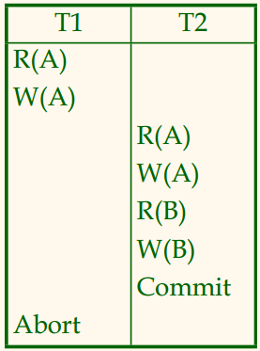
Characterizing Schedules Based On Recoverability
For some schedules it is easy to recover from transaction and system failures, whereas for other schedules the recovery process can be quite involved. In some cases, it is even not possible to recover correctly after a failure. Hence, it is important to characterize the types of schedules for which recovery is possible, as well as those for which recovery is relatively simple.
Recoverable schedule:
One where no transaction needs to be rolled back.
A schedule S is recoverable if no transaction T in S commits until all transactions T’ that have written an item that T reads have committed.
Non recoverable schedule: the below table contains two transactions, T1 reads and writes A and that value is read and written by T2. T2 commits but later on T1 fails. So we have rollback T1. since T2 has read the value written by T1 it should be rollback. But we have already committed that.
Non recoverable schedule

Slide 36
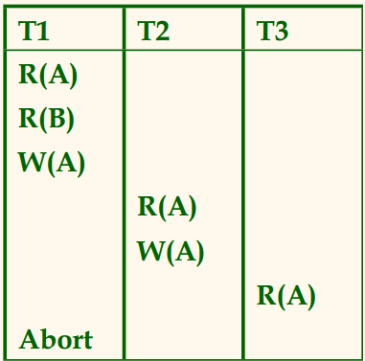
… Cont’d
Cascading rollback (Cascading Abort): occurs in some recoverable schedules when an uncommitted transaction has to be rolled back because it read an item from a transaction that failed
Cascadeless schedule: A schedule is said to be cascadeless, or to avoid cascading rollback, if every transaction in the schedule reads only items that were written by committed transactions. In this case, all items read will be committed, so no cascading rollback will occur.

Slide 37
… Cont’d
Strict Schedules:
A schedule in which a transaction can neither read nor write an item X until the last transaction that wrote X has committed.
Strict schedules are recoverable and cascadeless.
The cascadeless schedules will be a subset of the recoverable schedules, and the strict schedules will be a subset of the cascadeless schedules.
It is important to note that any strict schedule is also cascadeless, and any cascadeless schedule is also recoverable

Slide 38
Characterizing Schedules based on Serializablity
Serial schedule:
A schedule S is serial if, for every transaction T participating in the schedule, all the operations of T are executed consecutively in the schedule.
Otherwise, the schedule is called non serial schedule.
Schedule that does not interleave the actions of different transactions.
Serializable schedule:
A schedule S is Serializable if it is equivalent to some serial schedule of the same n transactions.
There is interleaved actions of different transactions.

Slide 39
… Cont’d
Being serializable is not the same as being serial
Being serializable implies that the schedule is a correct schedule.
It will leave the database in a consistent state.
The interleaving is appropriate and will result in a state as if the transactions were serially executed, yet will achieve efficiency due to concurrent execution.

Slide 40
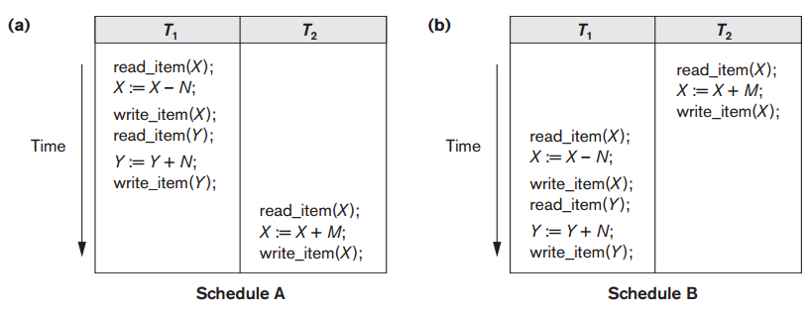
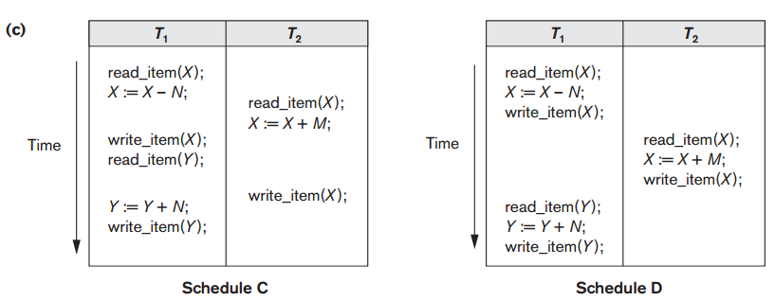
… Cont’d
Serial: A and B
Non serial: C and D

Slide 41
When are two schedules considered equivalent?
There are several ways to define schedule equivalence: Result equivalent: Two schedules are called result equivalent if they produce the same final state of the database.
Conflict equivalent: Two schedules are said to be conflict equivalent if the order of any two conflicting operations is the same in both schedules.
Conflict Serializable: Schedule S is conflict serializable if S is conflict equivalent to some serial schedule.
Every conflict serializable schedule is serializable.

Slide 42
?

